Slide 1
Unit-5 Network Programming in java
Compiled by:
Er. Juned Alam

Slide 2
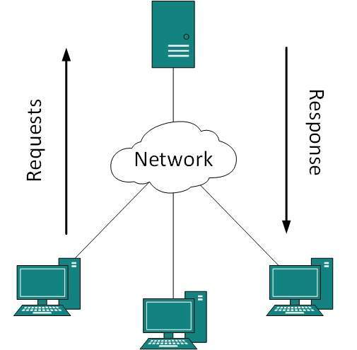
Elements of client-server computing

Slide 3
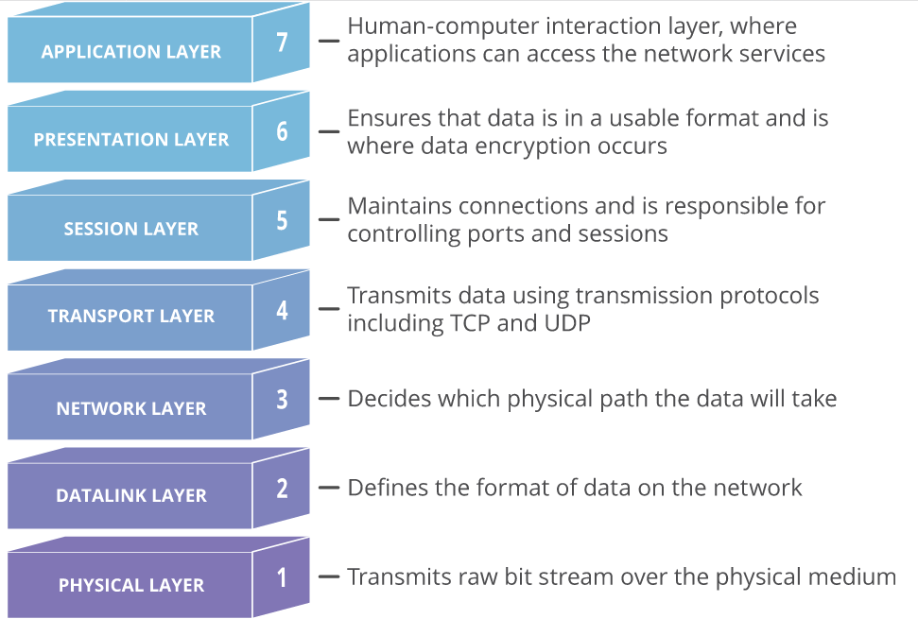
The OSI model

Slide 4
Transmission Control Protocol
A connection-based protocol that provides a reliable flow of data between two computers.
Provides a point-to-point channel for applications that require reliable communications.
The Hypertext Transfer Protocol (HTTP), File Transfer Protocol (FTP), and Telnet are all examples of applications that require a reliable communication channel.
Guarantees that data sent from one end of the connection actually gets to the other end and in the same order it was sent. Otherwise, an error is reported

Slide 5
User Datagram Protocol
A protocol that sends independent packets of data, called datagrams, from one computer to another with no guarantees about arrival. UDP is not connection- based like TCP and is not reliable:
Sender does not wait for acknowledgements
Arrival order is not guaranteed
Arrival is not guaranteed
Used when speed is essential, even in cost of reliability e.g. streaming media, games, Internet telephony, etc.

Slide 6
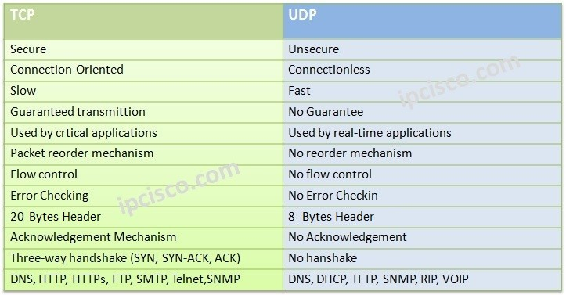
TCP vs UDP

Slide 7
Ports and IP address
Data transmitted over the Internet is accompanied by addressing information that identifies the computer and the port for which it is destined.
The computer is identified by its 32-bit IP address, which IP uses to deliver data to the right computer on the network. Ports are identified by a 16-bit number, which TCP and UDP use to deliver the data to the right application.

Slide 8
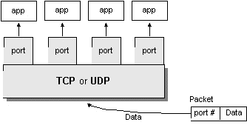
Ports continued
Port numbers range from 0 to 65,535 (16-bit)
Ports 0 - 1023 are called well-known ports. They are reserved for use by well-known services:
20, 21: FTP
23: TELNET
25: SMTP
110: POP3
80: HTTP
443: HTTPs

Slide 9
Networking Classes in the JDK
Through the classes in java.net package, Java programs can use TCP or UDP to communicate over the Internet.
The URL, URLConnection, Socket, and ServerSocket classes all use TCP to communicate over the network.
The DatagramPacket, DatagramSocket, and MulticastSocket classes are for use with UDP.

Slide 10
TCP/IP in Java
Accessing TCP/IP from Java is straightforward. The main functionality is in the following classes:
java.net.InetAddress : Represents an IP address (either IPv4 or IPv6) and has methods for performing DNS lookup
java.net.Socket : Represents a TCP socket.
java.net.ServerSocket : Represents a server socket which is capable of waiting for requests from clients.

Slide 11
Sockets and Java Socket Classes
A socket is an endpoint of a two-way communication link between two programs running on the network.
A socket is bound to a port number so that the TCP layer can identify the application that data destined to be sent.
java.net package provides two classes:
Socket – for implementing a client
ServerSocket – for implementing a server

Slide 12
Client Sockets
Java wraps OS sockets (over TCP) by the objects of class java.net.Socket
Creates a TCP socket and connects it to the remote host on the remote port (hand shake)
Write and read using streams:
InputStream getInputStream()
OutputStream getOutputStream()
It’s constructors are:
Socket(String remoteHost, int remotePort)
Socket(InetAddress ip, int remotePort)

Slide 13
Implementing a Client
Create a Socket Object:
client = new Socket( server, port_id );
Create I/O streams for communicating with the server.
is = new DataInputStream(client.getInputStream() );
os = new DataOutputStream( client.getOutputStream() );
Perform I/O or communication with the server:
Receive data from the server:
String line = is.readLine();
Send data to the server:
os.writeBytes("Hello\n");
Close the socket when done:
client.close();

Slide 14
ServerSocket
This class implements server sockets. A server socket waits for requests to come in over the network. It performs some operation based on that request, and then possibly returns a result to the requester.
A server socket is technically not a socket: when a client connects to a server socket, a TCP connection is made, and a (normal) socket is created for each end point.
It’s constructors are:
ServerSocket (int port) throws BindException, IOException
ServerSocket (int port, int maxQueue) throws BindException, IOException
ServerSocket (int port, int maxQ, InetAddress ip) throws IOException

Slide 15
Implementing a Server
Open the Server Socket:
ServerSocket server;
DataOutputStream os;
DataInputStream is;
server = new ServerSocket( PORT );
Wait for the Client Request: Socket client = server.accept();
Create I/O streams for communicating to the client
is = new DataInputStream(client.getInputStream() );
os = new DataOutputStream(client.getOutputStream());
Perform communication with client
Receive from client: String line = is.readLine();
Send to client: os.writeBytes("Hello\n");
Close sockets: client.close();

Slide 16
Accepting Connections
Usually, the accept() method is executed within an infinite loop
i.e., while(true){...}
The accept method returns a new socket (with a new port) for the new channel. It blocks until connection is made.
Syntax: Socket accept() throws IOException

Slide 17
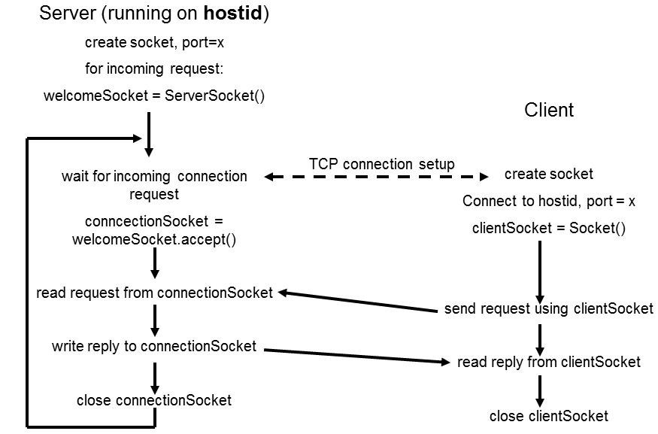
Client-Server Interaction via TCP

Slide 18
Datagrams
A datagram is an independent, self-contained message sent over the network whose arrival, arrival time, and content are not guaranteed.
The java.net package contains following classes to help you write Java programs that use datagrams to send and receive packets over the network: DatagramSocket and DatagramPacket
Sending Datagrams
public DatagramPacket(byte[] data, int length, InetAddress destination, int port)
public DatagramPacket(byte[] data, int offset, int length, InetAddress destination, int port)

Slide 19
Datagrams continued
DatagramSocket Constructors
public DatagramSocket( ) throws SocketException
public DatagramSocket(int port) throws SocketException
public DatagramSocket(int port, InetAddress interface) throws SocketException
Sending and Receiving Packets
public void send(DatagramPacket dp) throws IOException
public void receive(DatagramPacket dp) throws IOException

Slide 20
A typical UDP socket session
UDP socket processes, unlike TCP socket processes, are not clearly distinguished by server and client roles. The distinction is between connected and unconnected sockets.
An unconnected socket can be used to communicate with any host; but a connected socket, because it has a dedicated destination, can send data to, and receive data from, only one host.
Both connected and unconnected sockets send their data over the network without verification. Consequently, after a packet has been accepted by the UDP interface, the arrival and integrity of the packet cannot be guaranteed.

Slide 21
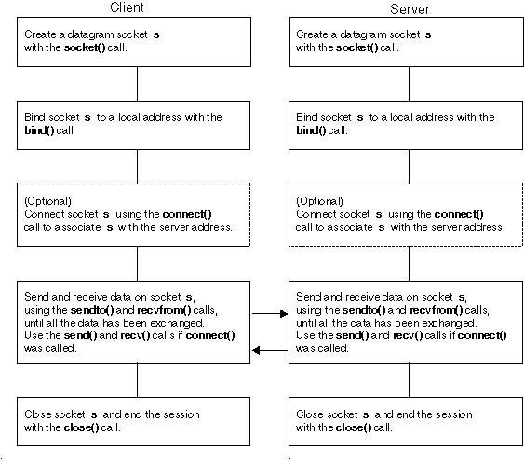
A typical datagram socket session

Slide 22
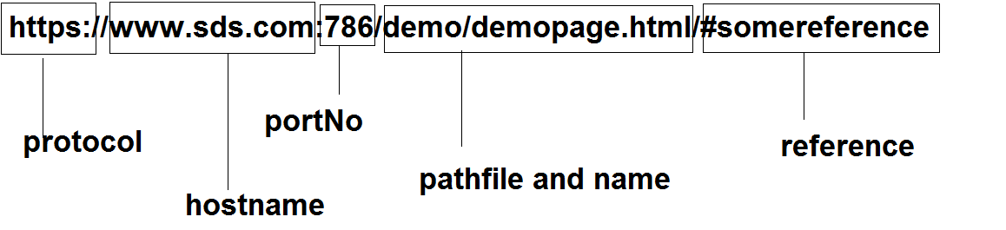
URL - Uniform Resource Locator
URL is a reference (an address) to a resource on the Internet. – A resource can be a file, a database query and more.
URLs are just a subset of the more general concept of Uniform Resource Identifiers (URIs) which are meant to describe all points in the information space.

Slide 23
URL Class
Class URL represents a Uniform Resource Locator, a pointer to a "resource" on the World Wide Web.
We distinguish between:
Absolute URL - contains all of the information necessary to reach the resource.
Relative URL - contains only enough information to reach the resource relative to (or in the context of) another URL.

Slide 24
URL class example
class URLDemo
{
public static void main(String args[]) throws MalformedURLException{
URL hp = new URL("http://content- ind.cricinfo.com/ci/content/current/story/news.html");
System.out.println("Protocol: " + hp.getProtocol()); System.out.println("Port: " + hp.getPort()); System.out.println("Host: " + hp.getHost()); System.out.println("File: " + hp.getFile()); System.out.println("Ext:" + hp.toExternalForm());
}
}
Output:
Protocol: http
Port: -1
Host: content-ind.cricinfo.com
File: /ci/content/current/story/news.html
Ext:http://content- ind.cricinfo.com/ci/content/current/story/news. html

Slide 25
URLConnection class
URLConnection is an abstract class that represents an active connection to a resource specified by a URL.
The URLConnection class has two different but related purposes. First, it provides more control over the interaction with a server (especially an HTTP or HTTPs server) than the URL class.
With a URLConnection, we can inspect the header sent by the server and respond accordingly.
We can set the header fields used in the client request.
We can use a URLConnection to download binary files.
Finally, a URLConnection lets us send data back to a web server with POST or PUT and use other HTTP request methods.

Slide 26
Process
Construct a URL object.
Invoke the URL object's openConnection( ) method to retrieve a URLConnection object for that URL.
Configure the URLConnection.
Read the header fields.
Get an input stream and read data.
Get an output stream and write data.
Close the connection.

Slide 27
URLConnection class features
URLConnection provides access to the HTTP header.
URLConnection can configure the request parameters sent to the server.
URLConnection can write data to the server as well as read data from the server.

Slide 28
Javax.mail API
The JavaMail API provides a platform-independent and protocol-independent framework to build mail and messaging applications.
Firstly, allow the less secure app to communicate in gmail.
Paste the following lines in pom.xml to get access to the mail API.
<dependencies>
<dependency>
<groupId>com.sun.mail</groupId>
<artifactId>javax.mail</artifactId>
<version>1.6.2</version>
</dependency>
</dependencies>
For more details, refer to last section of unit-4 slides.
Please refer to the github repository for the mail related codes.

Slide 29
Thank you! Please visit https://github.com/junedrepos/sagarmathaCsitJava2021 for the codes

